Slide 1
Morphology
Universidade Federal do Amazonas
Digital Image Processing
Profª Marly Guimarães
Allann Jones de Oliveira Silva

Slide 2
Boundary Extraction
Morphology

Slide 3

Boundary Extraction Definition
Boundary of a set A of foreground pixels:
β(A) = A – (A Ɵ B)
Where
A = Original image.
β(A) = A’s border.
Ɵ = Erosion operator.
B = Structuring element.

Slide 4
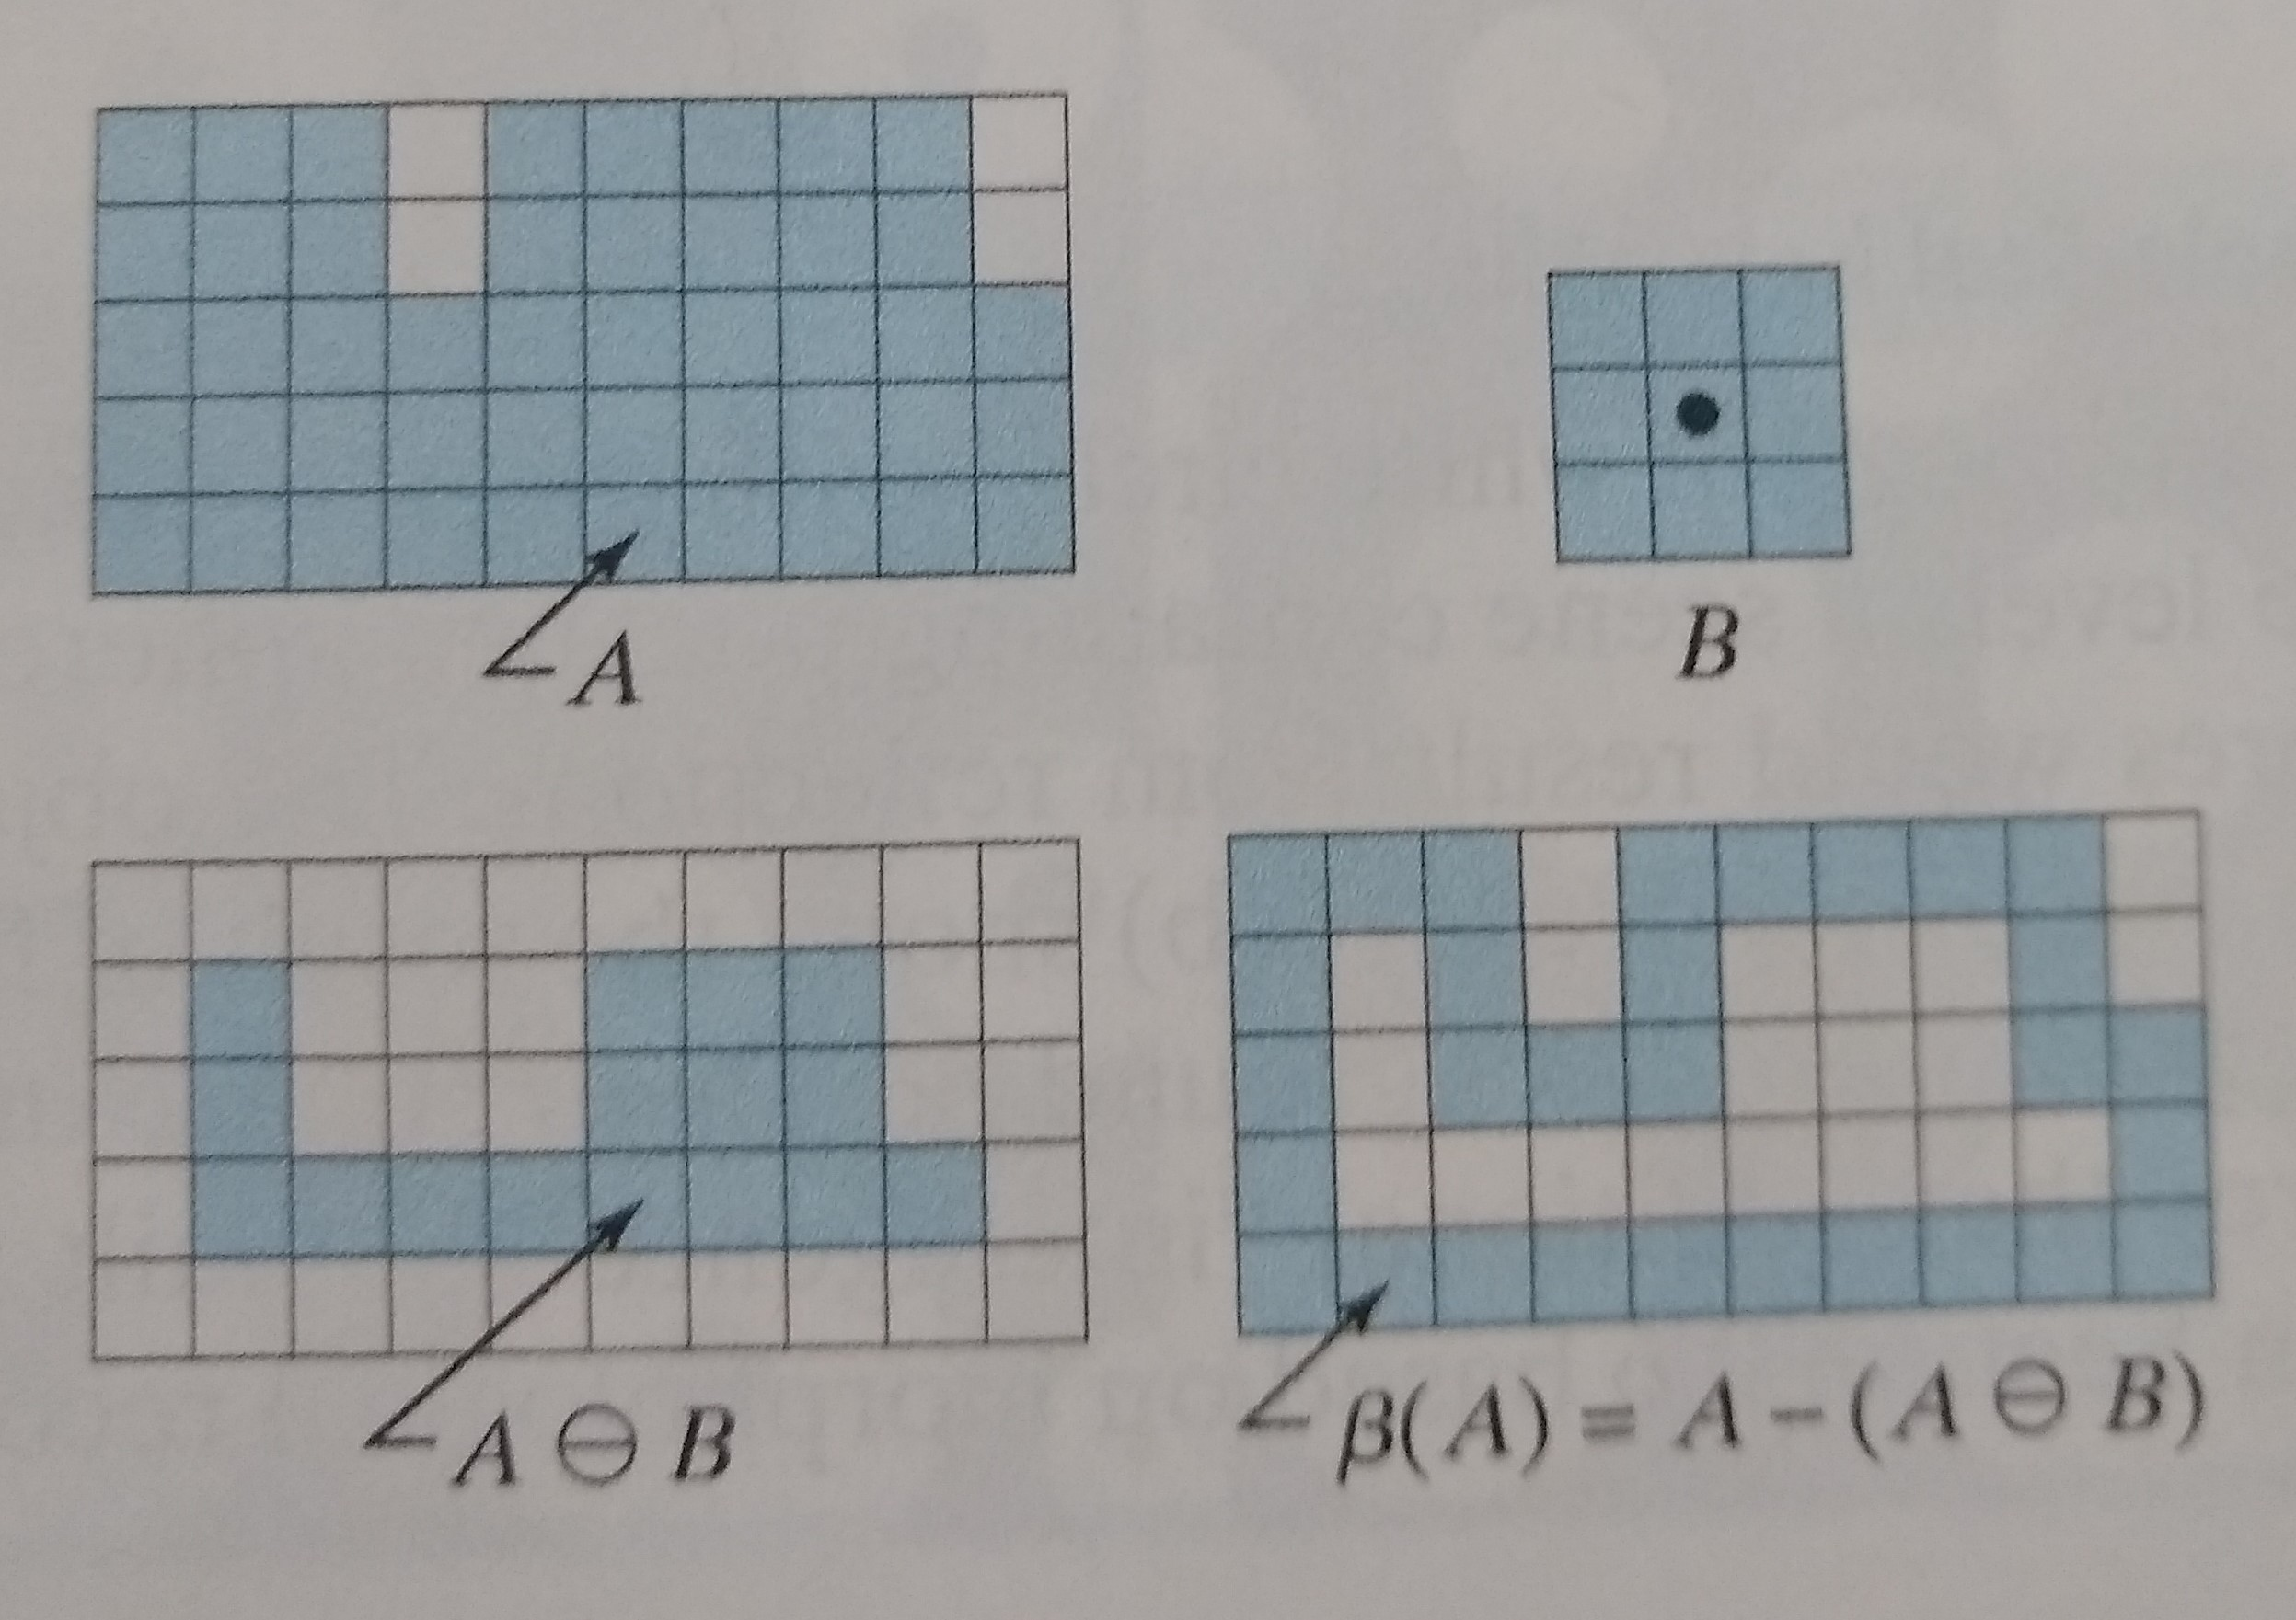
Boundary Extraction Implementation

Slide 5
Boundary Extraction Implementation
https://github.com/allanjos/image_processing/blob/master/master_degree/morphology/morphology_boundary_extraction.m

Slide 6
Hole Filling
Morphology

Slide 7
Holly Filling Definition
Each boundary enclosing a background region (i.e., a hole).
X_{k} = (X_{k-1} Ꚛ B) Ո I^{c} k = 1, 2, 3, ...
Until X_{k =} X_{k-1}
X₀ is the position of the boundary of the hole.
Ꚛ is the dillution operator.
B is a symmetric structuring element (SE).
Ո is the intersection operation
I^{c} is the complement of original image.

Slide 8
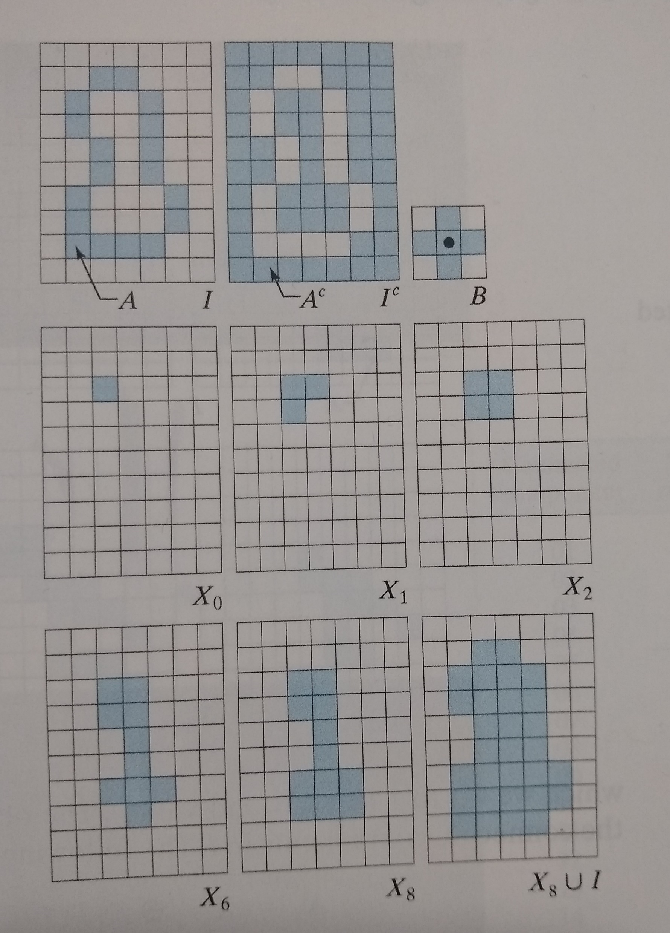
Holly Filling Implementation

Slide 9
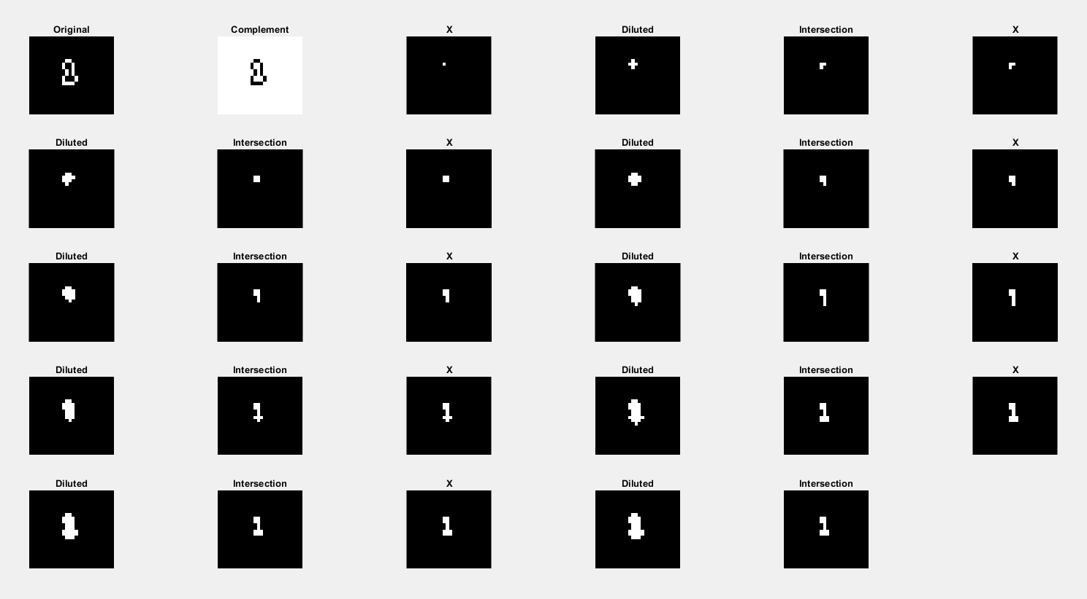

Slide 10
Holly Filling Implementation
https://github.com/allanjos/image_processing/blob/master/master_degree/morphology/morphology_hole_filling.m

Slide 11
Extraction of Connected Components
Morphology

Slide 12
Extraction of Connected Components Definition
Extract connected components (foreground pixels) from a binary image.
Each boundary enclosing a background region (i.e., a hole).
X_{k} = (X_{k-1} Ꚛ B) Ո I k = 1, 2, 3, ...
Until X_{k =} X_{k-1}
X₀ is the position of the boundary of the hole.
Ꚛ is the dillution operator.
B is a symmetric structuring element (SE).
Ո is the intersection operation
I is the original image.

Slide 13
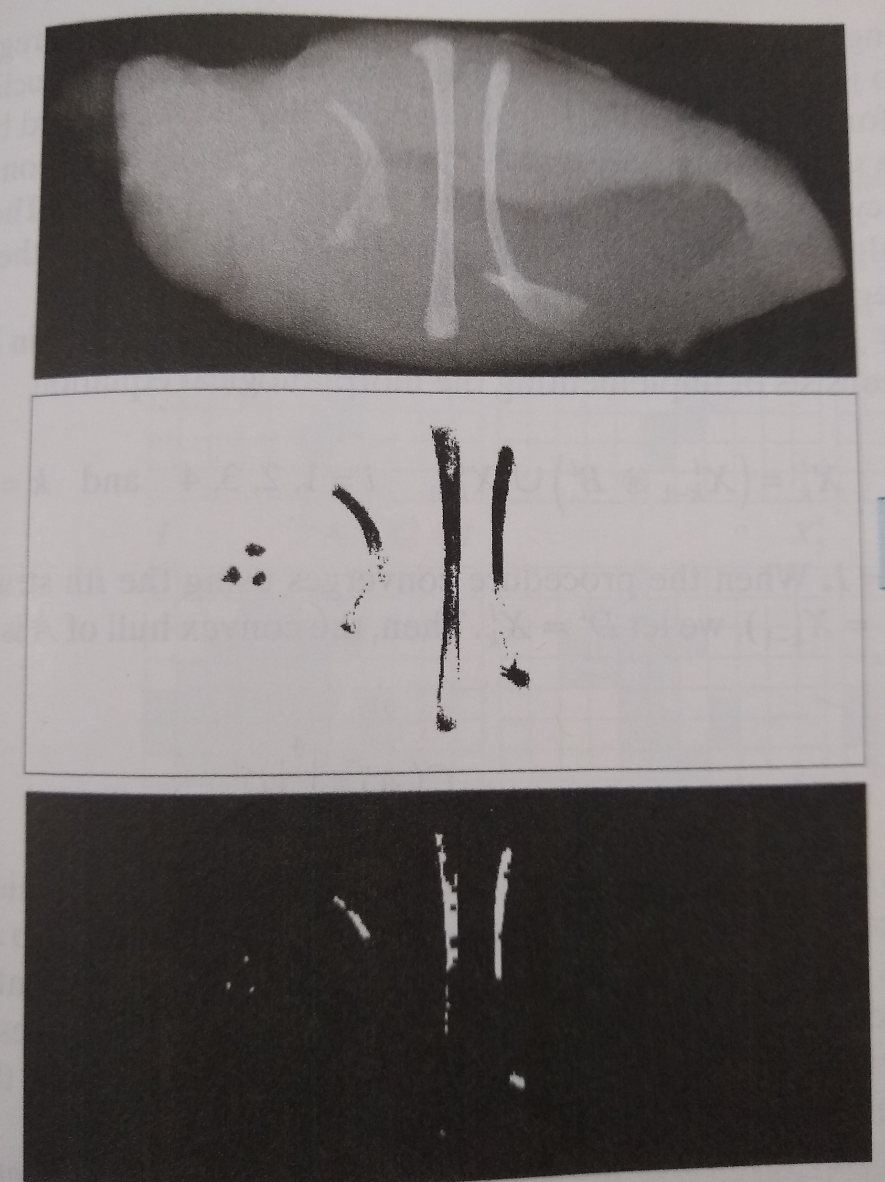
Extraction of Connected Components Application

Slide 14
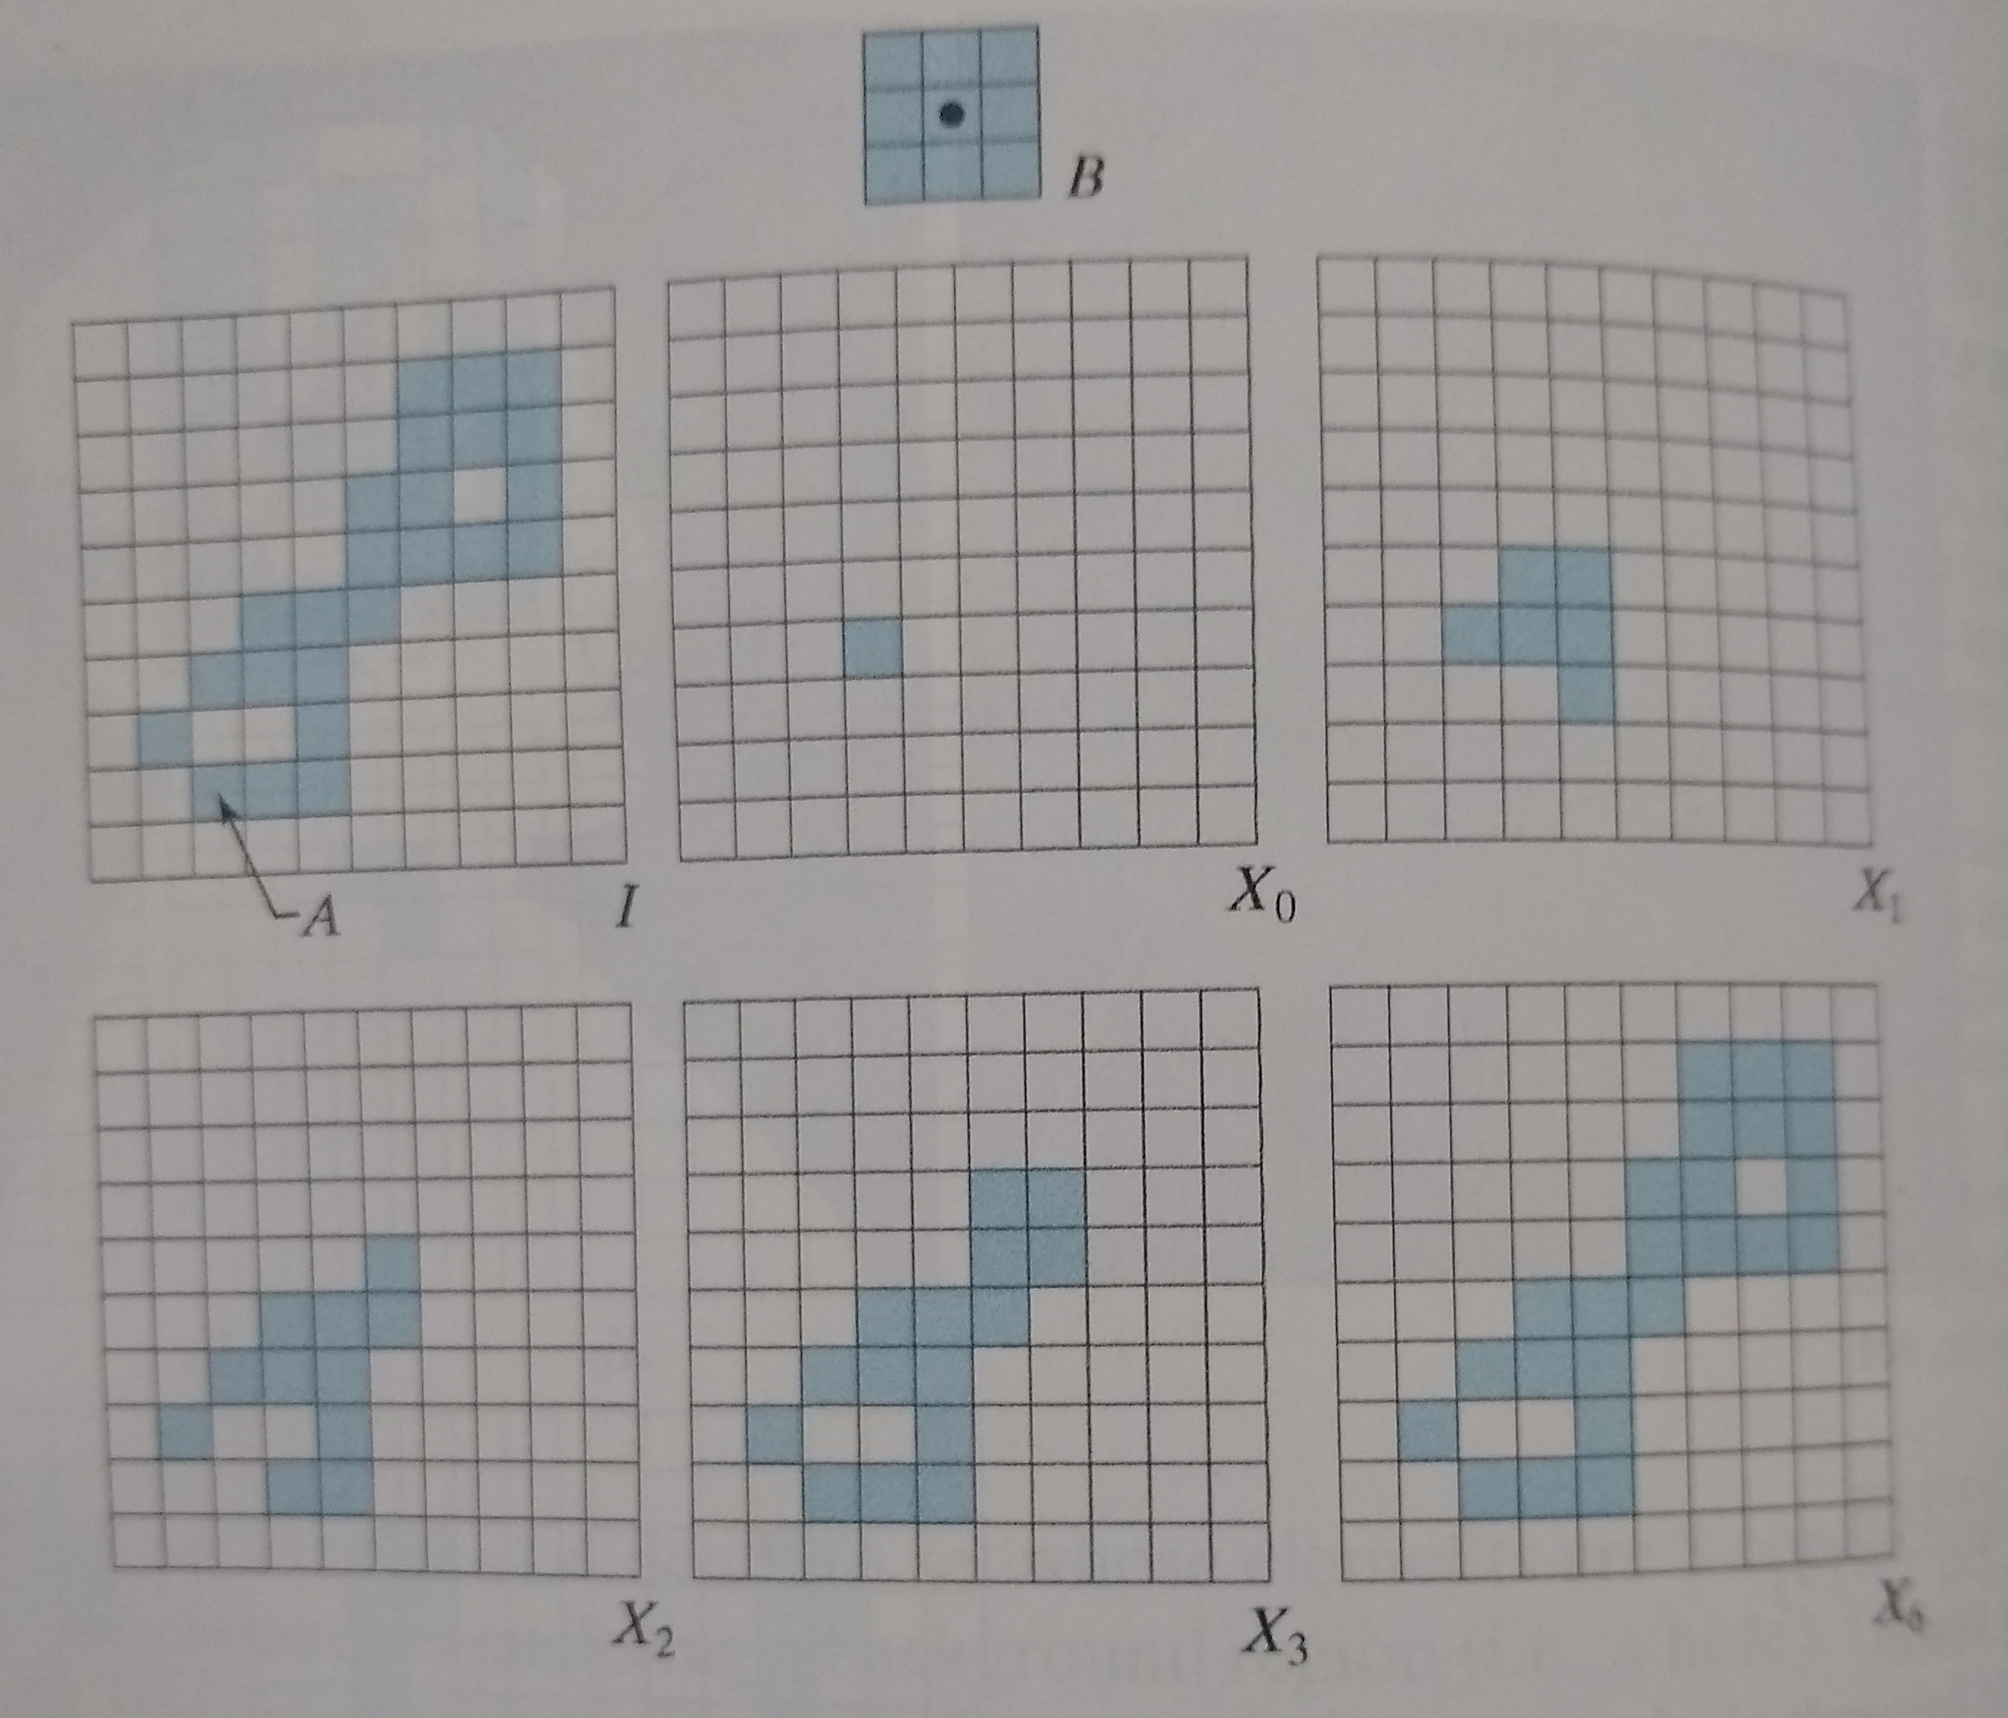
Extraction of Connected Components Implementation

Slide 15
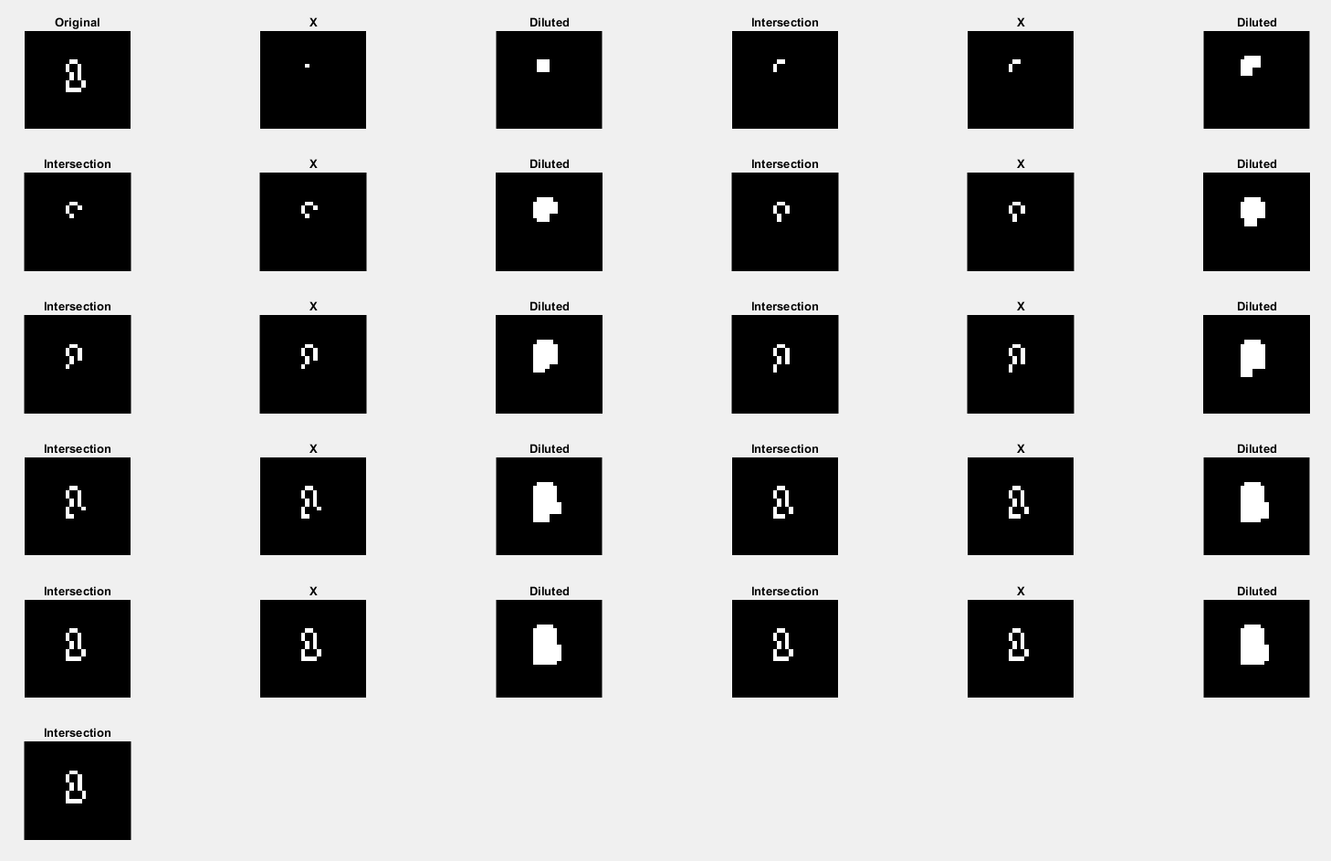

Slide 16
Extraction of Connected Components Implementation
https://github.com/allanjos/image_processing/blob/master/master_degree/morphology/morphology_extract_connected_components.m

Slide 17
Convex Hull
Morphology

Slide 18
Convex Hull Definition
A convex set S of points in the Euclidean plane.
Convex Hull (H) is the smallest convex set containing S.
Convex deficiency = H – S
Digital plane with discrete coordinates.
Each boundary enclosing a background region (i.e., a hole).
X^{i}_{k} = (X^{i}_{k-1} * B^{i}) Ս X^{i}_{k-1} i = 1, 2, 3, 4 and k = 1, 2, 3, ...
Until X^{i}_{k =} X^{i}_{k-1}
X₀ is the position of the boundary of the hole.
Ꚛ is the dillution operator.
B is a symmetric structuring element (SE).
Ո is the intersection operation
I is the original image.

Slide 19
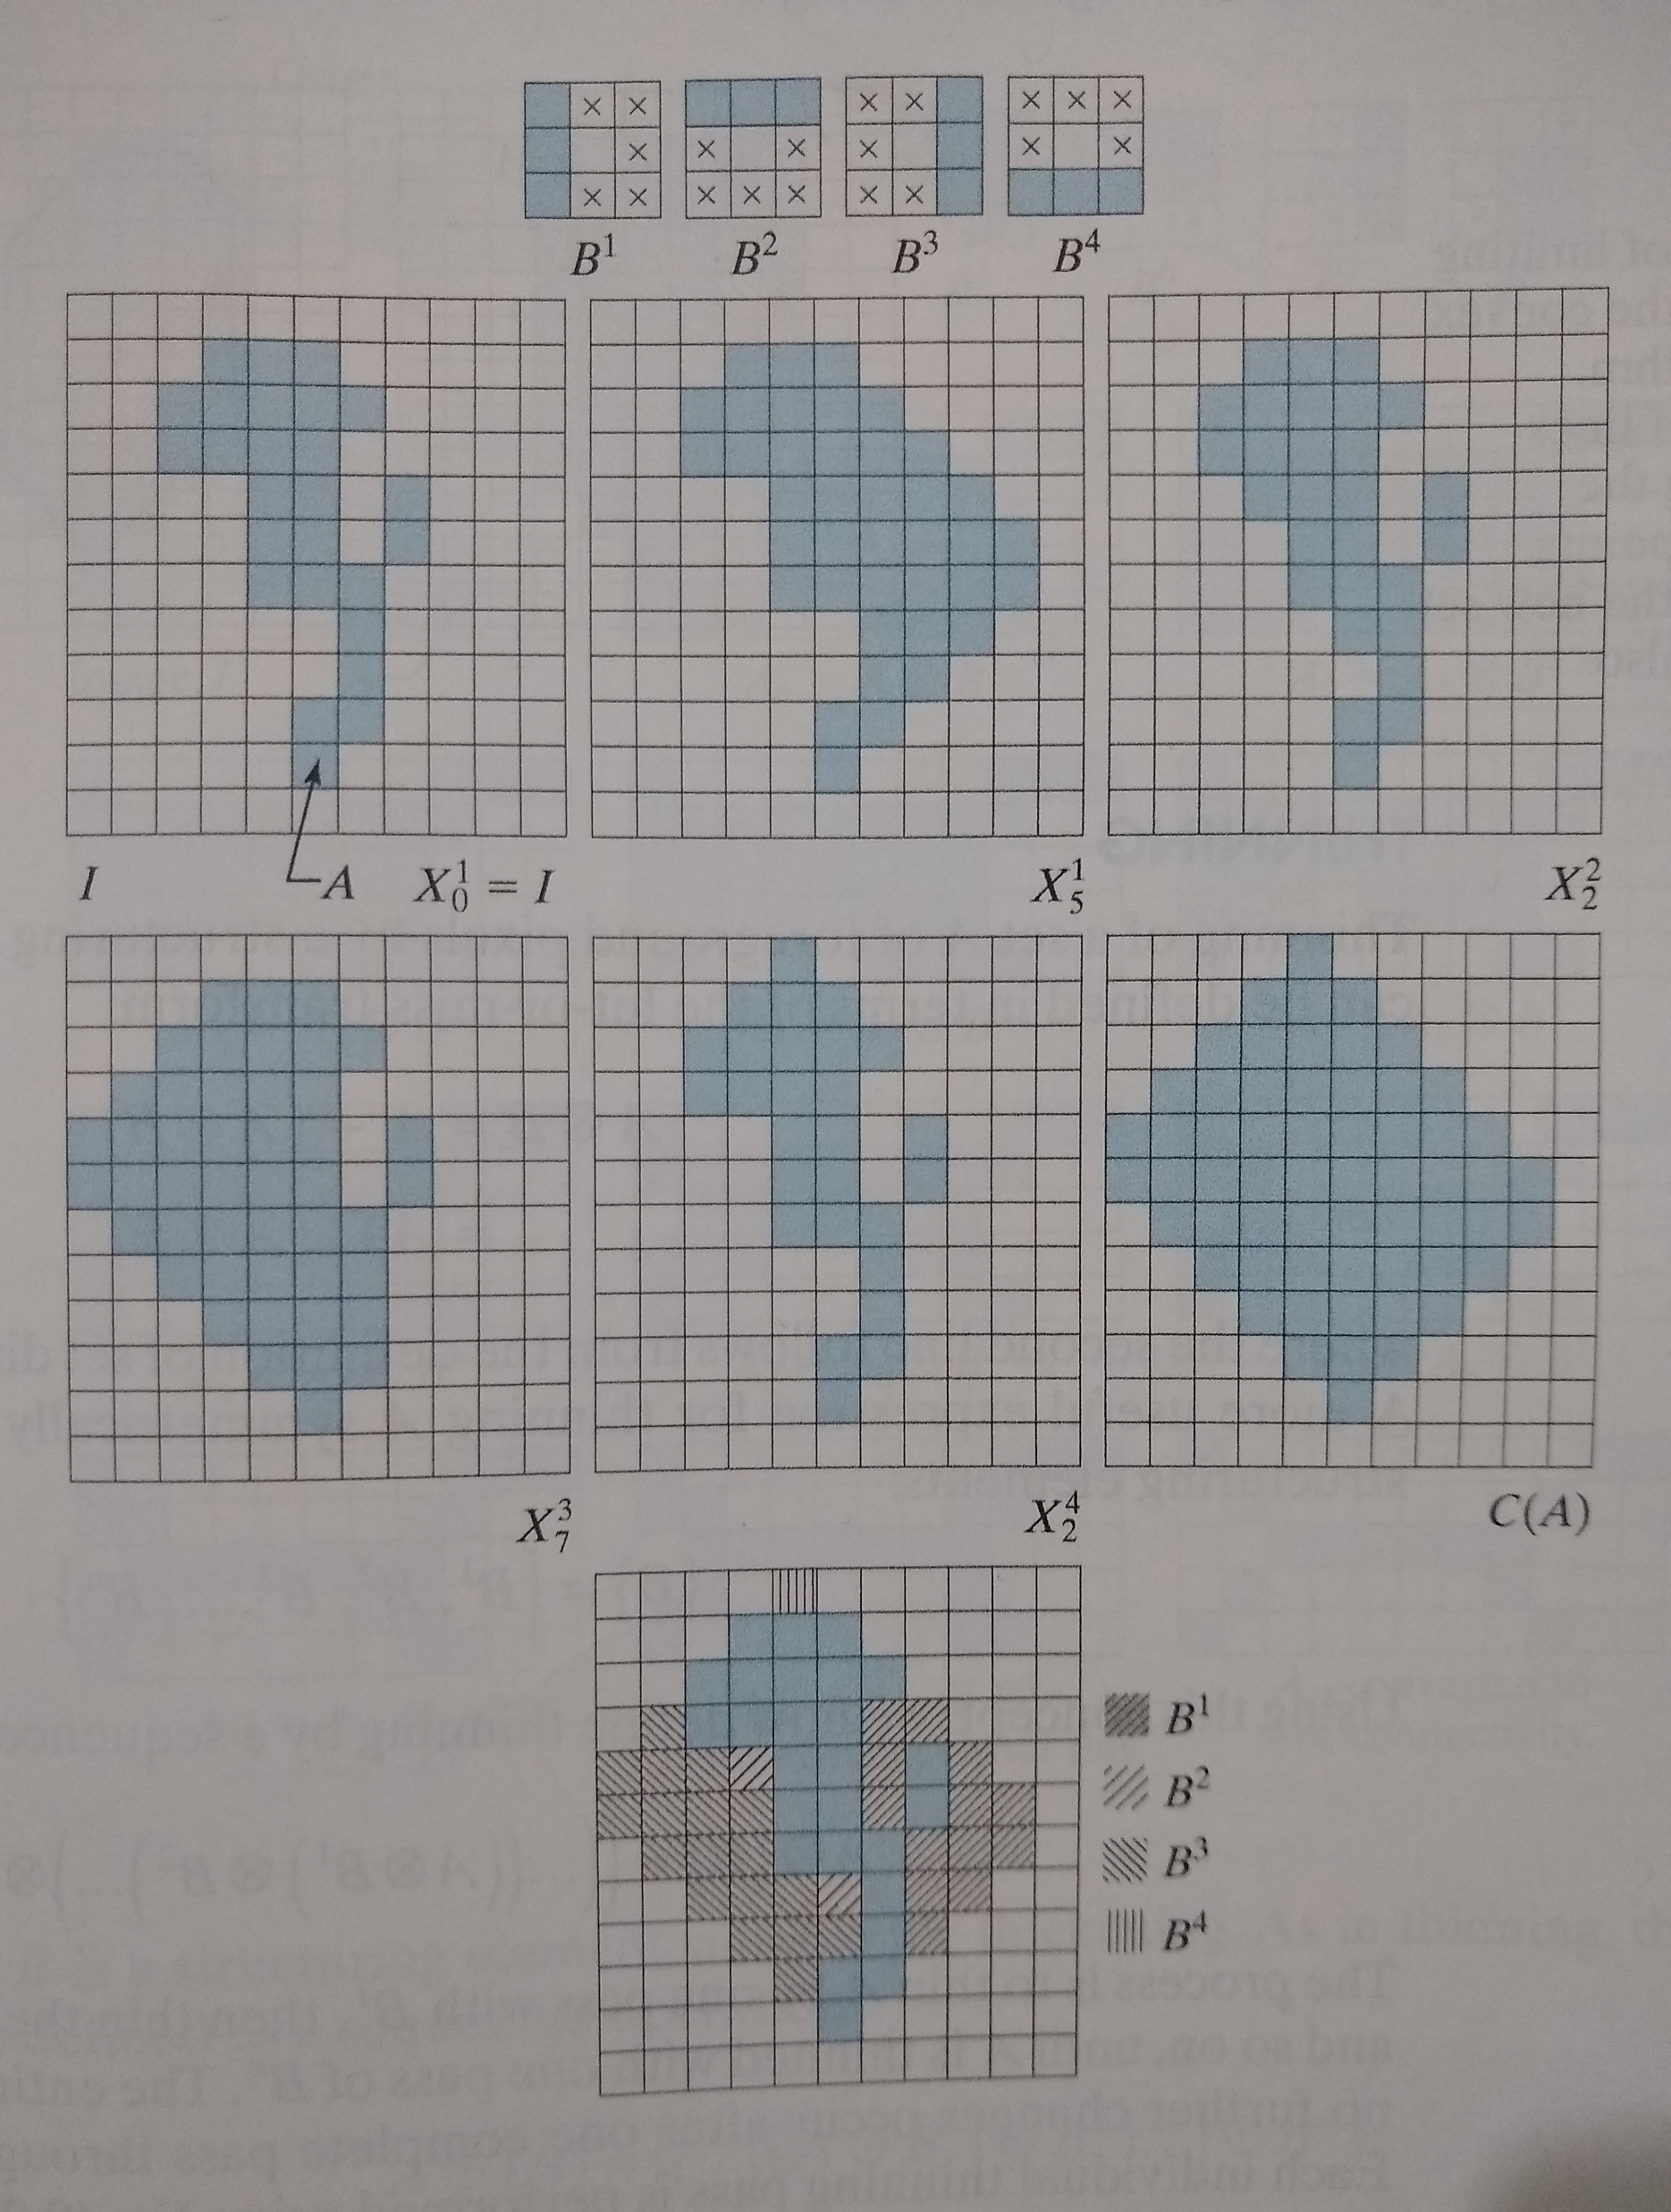
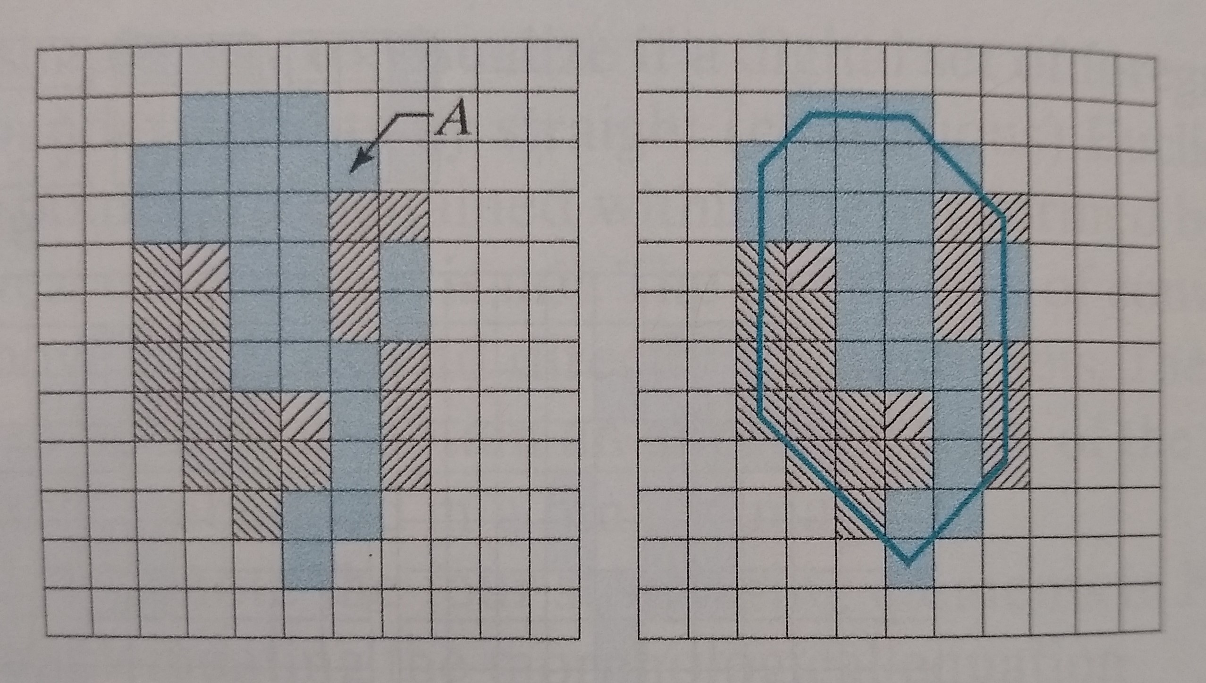
Convex Hull Implementation

